Slide 1
Vaccination Credential Initiative

Slide 2
An Initiative of U.S. Vaccine Stakeholders
March 2021 General Membership Meeting

Slide 3
Collaborating Partners

Slide 4
Agenda
1
COVID: The Long(er) View
2
Vaccine Credential Initiative
3
Mission and Use Cases
4
Standards and Technologies
5
Reference Implementations

Slide 5
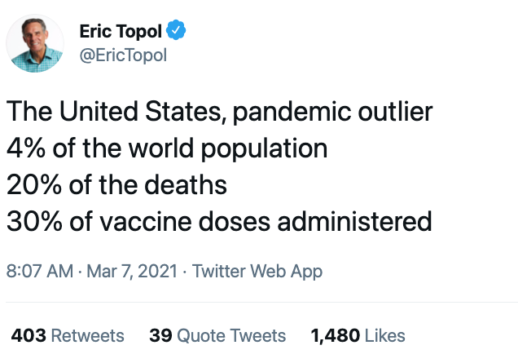
COVID: The Long(er) View

Slide 6
COVID: The Long(er) View
Available COVID-19 vaccines provide a line-of-sight by extinguishing human SARS-Co-2 transmission and stopping the pandemic by achieving and maintaining high vaccine coverage (approximately 75-80%) in populations
Achieving high vaccine coverage is dependent on a complex set of requirements including: vaccine supply, logistics for vaccination, access, and demand for vaccination – and is a global scale challenge, not just a single country

Slide 7
COVID: The Long(er) View
There are three other largely unknown factors that could affect the difficulty (and the timelines) in achieving and maintaining high (effective) vaccine coverage, and each of these are vaccine-specific uncertainties:
Uncertain effectiveness of vaccines ability to prevent asymptomatic infection and risk transmission
Unknown duration of vaccine protection for symptomatic and asymptomatic infections
Emergence of SARS-CoV-2 viral variants which may “escape” vaccine protection

Slide 8
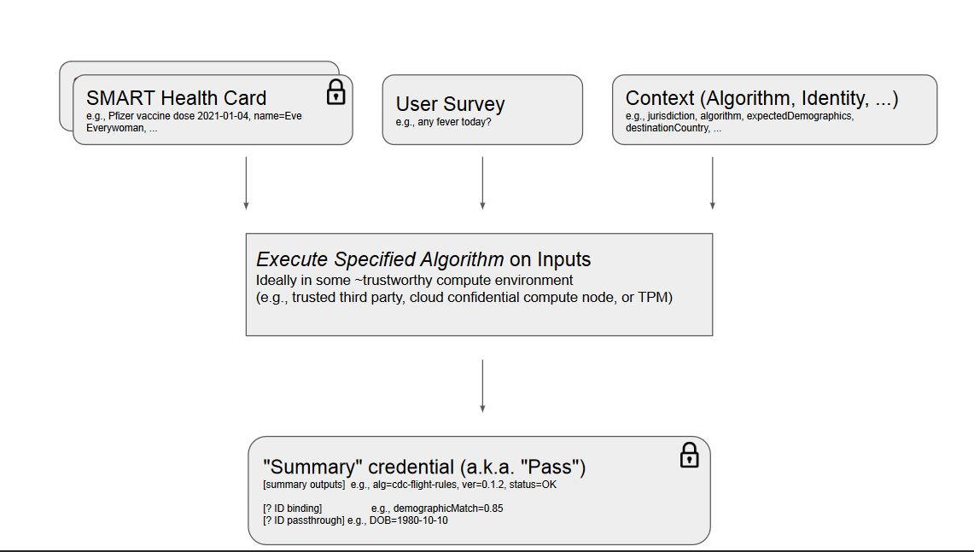
The Initiative
The scope of the Vaccine Credentialing Initiative (VCI) is to harmonize the standards and produce the implementation guides needed to support "signed clinical data" bound to an individual identity.
The initial use case is to enable a user to access a signed copy of their clinical data in a standard format that can then be shared with another entity such as an airline, hotel, school, business, or event organizer. That entity can verify that the identity matches their records, and that the data is intact, then they can do whatever they want with it, such as embed within a boarding pass or ID badge.
The attached diagram illustrates the VCI scope - production of the SMART Health Card (the upper right-hand corner of the first slide). Other components such as wallets, verifiers, and identity proofing are out of scope. There is no charge for use of VCI created standards and implementation guides. No one entity holds IP rights to the work or can claim control over its use. Verifiers following these specifications have (by the way the specs are designed) a freely available path to validating signatures, with no pre-arrangement or transactional costs. In other words, verifiers can validate signatures on a Health Card using only publicly available resources (i.e., the openly published, web accessible JWKS files).

Slide 9
Participation
General Membership
Added to mailing list
Eligible to attend monthly general meeting
Eligible to participate in ad hoc working groups as necessary
Working Groups
Provides business and technical resources for reference implementations
Assigned to and participates in regularly scheduled standing working groups meetings
Steering Committee
Technologies
Registries
Health Plans
Health Systems
General Membership
Implementers

Slide 10
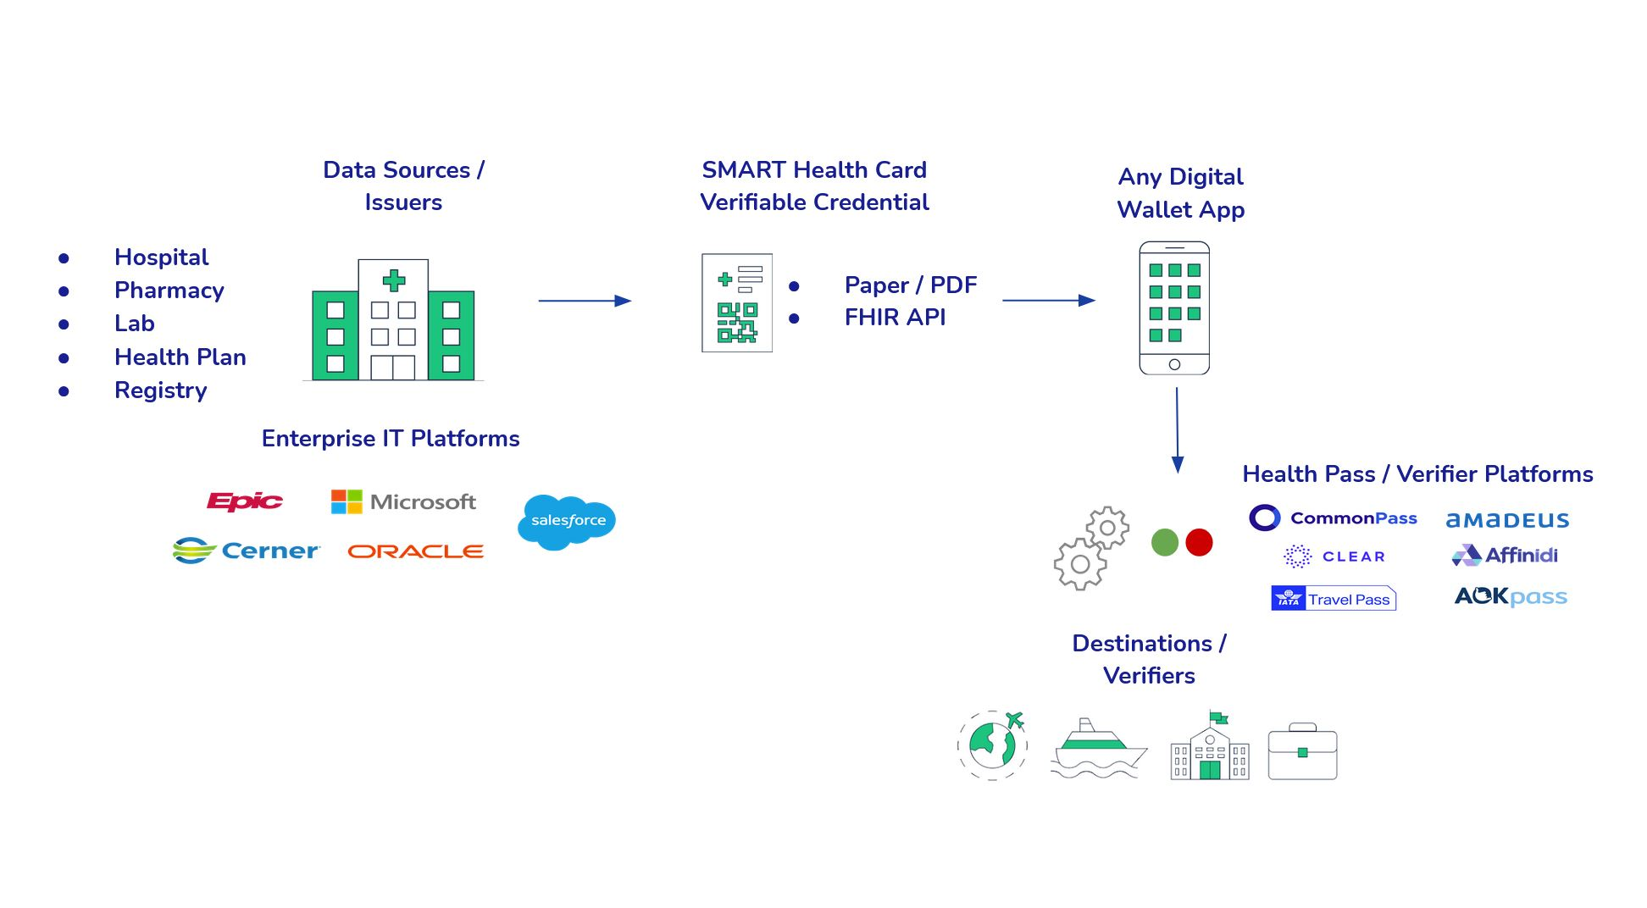
Mission and Use Cases

Slide 11
Standards and Technologies
VCI is building two core specifications:
SMART Health Cards Enabling individuals with verifiable health data
SMART Health Cards: Vaccination & Testing Apply SMART Health Cards to vaccinations and COVID-19
https://smarthealth.cards/ http://build.fhir.org/ig/dvci/vaccine-credential-ig/branches/main/

Slide 12
SMART Health Cards: Vaccination & Testing IG
FHIR Implementation Guide
Applies SMART Health Cards Framework to COVID-19 vaccination use case
Data Profiling and Minimization
Profiles for Patient and Immunization resources
Only disclose a minimum amount of information to verifier
Additional Use Cases
COVID related lab tests
http://build.fhir.org/ig/dvci/vaccine-credential-ig/branches/main/

Slide 13
Cerner’s Work with VCI
Participating in development of the SMART Health Cards Framework and Vaccination and Testing IG.
SMART Health Cards will be available though Ignite APIs for Millennium
Planning 2H 2021 rollout in US
Contact:
Michael Turman
Sr. Product Manager
michael.turman@cerner.com

Slide 14
Provider Perspective on VCI
William Gordon, MD, MBI
Director, Solution & Experience, Digital Care Transformation, Mass General Brigham
Associate Physician, Brigham and Women’s Hospital
Instructor in Medicine, Harvard Medical School
Adam Landman, MD, MS, MIS, MHS
Chief Information Officer and Vice President, Digital Health, Brigham Health
Associate Professor, Harvard Medical School
Disclaimer: views expressed here do not necessarily reflect those of our employers

Slide 15
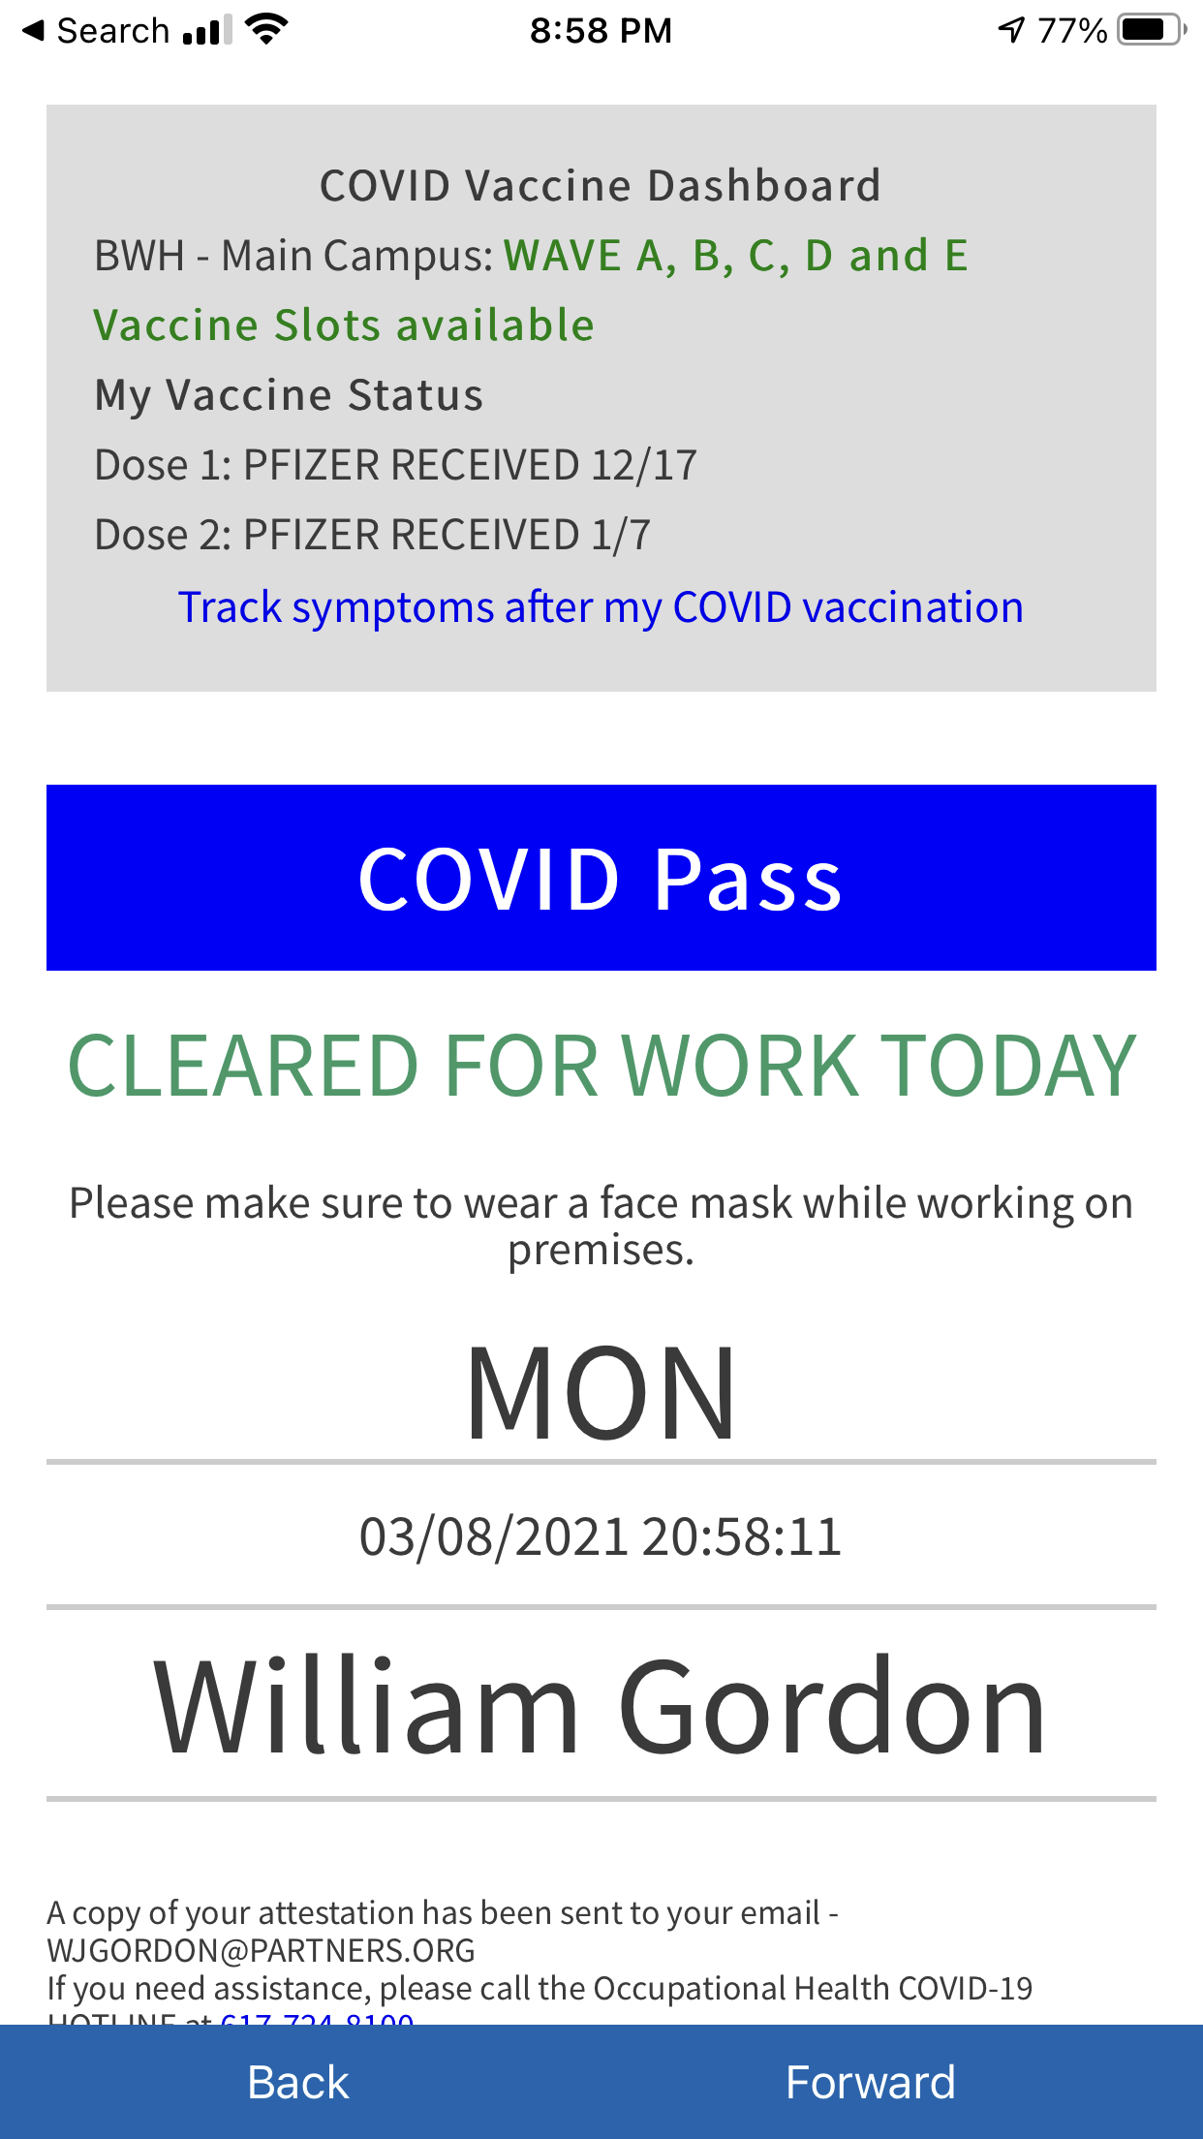
Background
Early adopter of patient-facing APIs
Sync for Science and Apple Health Records on iPhone
Implementation site and collaborator for CommonHealth
Now live with both Apple and Android options for patients
Early research on patient-facing APIs
Work published in NEJM Catalyst, JAMA Network Open, JMIR
Epic EHR across the delivery network
Home-grown “COVID Pass” screening and scheduling app
Used daily by >50,000 employees, integrated with EHR, and vaccine scheduling

Slide 16
Initial Considerations and Approach
Convened a working group of internal innovators to understand the use-case, including technical, operational, and clinical considerations.
Consideration | Approach
Can we make a patient’s immunization record available digitally? | Immunizations are already available via the patient-access API
Equity considerations behind requiring a digital passport for travel, entertainment, etc. | Non-digital options (e.g., PDF of barcode), though does not address fully
Technical build requirements | Will our EHR vendor build this, or will it be custom? Are the standards mature enough to develop against?
State immunizations registries | How would we manage immunizations reported in our EHR, but done elsewhere (either through state exchange or provider report?)
End-users | Should we pilot with a smaller set of patients, like our employees?
Verifiers and holders | What is our relationship with holders and verifiers, and in particular, what is the trust model and our organizational risk?
Potential role in furthering disparities or restricting access to essential services | What will be the impact of enabling this more broadly particularly given health inequities exposed by COVID-19?

Slide 17
Status
Working with the VCI team on advancing the SMART Health Cards standard through regular meetings, email, and chat.fhir.org
Many important considerations raised so far – what is the right trust model, how do we deal with state immunization data, is there a potential ”write-back” use case, among others
The multi-stakeholder, not-for-profit, and transparent approach to VCI has been effective at moving towards consensus
Working towards understanding whether it will make sense for our organization to digitally sign health records data for our patients

Slide 18
Wrap Up
Sign up on the site if you haven’t already
https://vaccinationcredential.org/
Check out the specs and talk with the team on GitHub
https://smarthealth.cards/
http://build.fhir.org/ig/dvci/vaccine-credential-ig/branches/main

Slide 19
VCI
Website: https://vaccinationcredential.org
SMART Health Card Framework and Technical Details: smarthealth.cards

